Slide 1

SI 507 FALL 2022 Intermediate Programming
Madamanchi

Slide 2
Today’s Agenda & Learning Objectives
Course Overview
Understand how SI 507 is going to be run
Understand how to be successful in this course
Python Basics Refresher
To review the fundamentals of Python that you have previously learned
User Inputs
Understand how to write commands that ask for different types of user input
Understand how to write commands that make sure user inputs are viable
Functions
Scope (global vs local)
Structure

Slide 3
What do you learn in SI 507?
Programming Skills & Confidence
Hidden Curriculum
Data Structures
Troubleshooting
Accessing Data
Algorithms
Notes:
SI 507 is a course about programming. 507 covers a number of very interesting and useful topics, such as using Web APIs, scraping data from web sites, version control, working with databases, and building web applications. But these topics are only part of the point of 507. The secret agenda of 507 (which I guess is about to be not-so-secret) is to make you a better programmer. By building programs—many of them, each bigger and better than the last—you will leave this class with the skills and confidence to tackle serious programming tasks and develop more sophisticated technical skills, whether your interests lie in application development, data management and curation, data analysis, or any of dozens of other applications of programming.

Slide 4
What do you learn in SI 507?
Programming Skills & Confidence
Hidden Curriculum
Data Structures
Troubleshooting
Accessing Data
Algorithms
Getting Better at Python

Slide 5
What do you learn in SI 507?
Programming Skills & Confidence
Hidden Curriculum
Data Structures
Troubleshooting
Accessing Data
Algorithms
Using Python with the Outside World

Slide 6
Required Background Knowledge
Introductory Programming Concepts
Sequential Execution – top to bottom
Variables – hold a value and that value can vary
Loops (iteration) – repeat a statement or block
Conditionals – conditionally execute a statement
Functions – name a block of statements and execute using the name
Week 1 Suggested Reading: First 9 Sections of https://jakevdp.github.io/WhirlwindTourOfPython/
Introduction
How to Run Python Code
Basic Python Syntax
Python Semantics: Variables
Python Semantics: Operators
Built-In Scalar Types
Built-In Data Structures
Control Flow Statements
Defining Functions
Notes:
The title of this course is “intermediate programming.” “Intermediate,” of course, means “between beginning and advanced.” Many of you, prior to taking this course, have taken only one programming course—a beginning programming course. A few more of you have taken a handful of courses or maybe picked up some coding here and there, but you are still looking to solidify your knowledge and skills. Some of you have done a lot of programming, either through coursework or elsewhere, but you’re here anyway (we’ll get to you in a minute). Regardless of where you are now, my goal for this semester is to get you ready for advanced study, whether in courses or on your own, so that you can master what you want to master in order to do what you want to do.

Slide 7
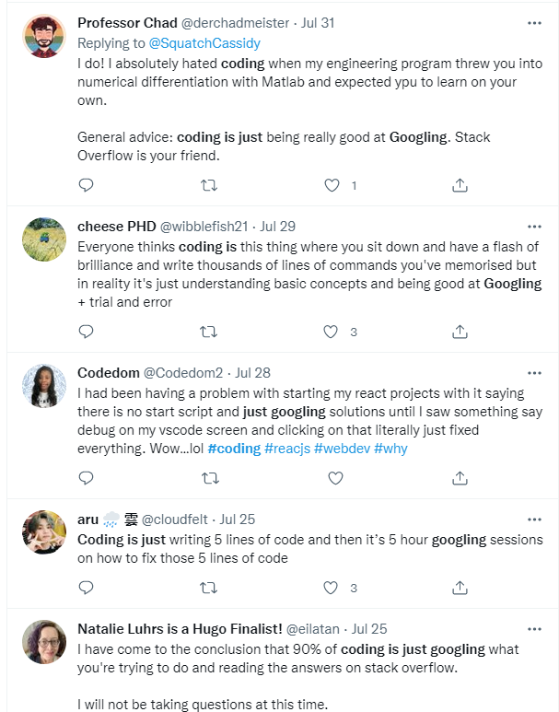
How to Become A Good Programmer
How to be SUCCESSFUL in SI 507

Slide 8




My Journey
B.S. Biology Duke University
Zero lines of code!
Ph.D. Cancer Biology Vanderbilt University
Bobby Madamanchi
Data Science Lecturer III School of Information University of Michigan
Postdoctoral Research Computational Biology Purdue University
Postdoctoral Research Future Work & Learning Purdue University

Slide 9

My Journey
B.S. Biology Duke University
Zero lines of code!
Ph.D. Cancer Biology Vanderbilt University
Postdoctoral Research Computational Biology Purdue University
Postdoctoral Research Future Work & Learning Purdue University
Informatic Analyses using R

Slide 10
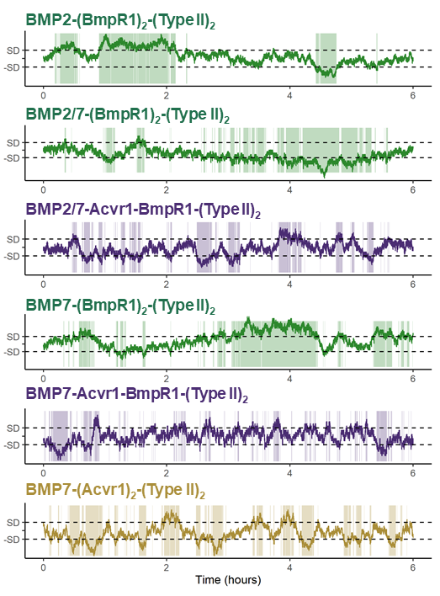
My Journey
B.S. Biology Duke University
Zero lines of code!
Ph.D. Cancer Biology Vanderbilt University
Postdoctoral Research Computational Biology Purdue University
Postdoctoral Research Future Work & Learning Purdue University
Stochastic Receptor Simulations using Python

Slide 11
My Journey
Developed a theoretical framework for teaching computational and data science: “Computational Apprenticeship”
Co-authored 8 studies on student learning experiences with python.
Implemented python curricular modules in multiple disciplines
B.S. Biology Duke University
Zero lines of code!
Ph.D. Cancer Biology Vanderbilt University
Postdoctoral Research Computational Biology Purdue University
Postdoctoral Research Future Work & Learning Purdue University

Slide 12
The keys to learning python
Sustained engagement
HW suggested due date is at 7PM EDT on Monday 2 weeks after the HW is assigned.
Don’t wait until then!
Review old material
Do not multi-task.
Metacognition
Reflection
In-code Comments
Social Learning
Use the Piazza. piazza.com/umich/fall2022/si507 (signing up is worth 10 points)
Post & Answer questions.
Learn by Doing
Labs & HW more important than lecture.
Notes:
You’re the main character – reach out for help, for extensions etc.
There are almost 200 of you
Slack use – DMs; vs posting questions.
Make sure you’re in the 001 canvas section

Slide 13
Peer-to-Peer Learning
I can not stress this enough!

Slide 14
The keys to learning python during a Pandemic!
Plan ahead
Be flexible

Slide 15
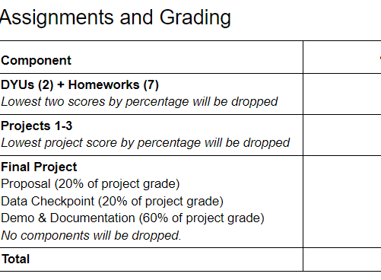
Course Grading
Do not cheat yourself!
Do not abuse flexibility
Notes:
Style and Pace
For those of you for whom 507 is designed—folks who are emerging from beginnerhood into intermediatehood—this course is likely to be challenging. We cover a lot of different topics that might seem at first as though they don’t have much direct connection to each other (though hopefully their interconnections will make more sense by the end). We also write a lot of code. Since this course is not just about building knowledge but also about building skill, practice is key. To provide that practice, we’ll give you lots of chances to get your hands dirty and write programs that apply the concepts and techniques that are discussed in class. You will have a homework assignment every week (more or less), as well as four meaty projects—about one every 3 or 4 weeks. There will also be online, self-paced quizzes to test your knowledge every couple of weeks. The deadlines have been carefully planned (and are still being tweaked) to ensure everything can be done with a reasonable amount of effort, but there won’t be much time for coasting or letting things slide. If you keep showing up and pushing things along, though, you should be just fine.
Now lets review the syllabus.

Slide 16
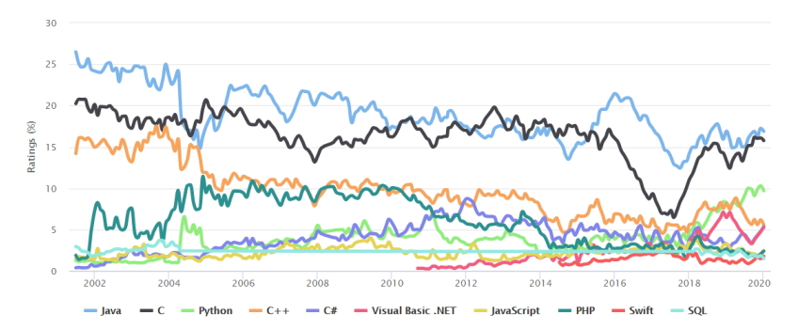
What is Python?
An Object-oriented programming language
With objects and classes
The fastest-growing programming language
Lots of companies use it
Named for Monty Python's Flying Circus
A BBC comedy series from the 1970s
Heavily used for data science, web development, and machine learning
Lots of libraries to make things easier
Notes:
See https://www.netguru.com/blog/why-python-is-growing-so-quickly-future-trends
And
https://docs.python.org/2/faq/general.html

Slide 17

Classes and Objects
Object-oriented programming is what makes python powerful & one of the main goals of this class is to get comfortable with classes & objects.
Classes define what objects of the class know (attributes) and do (behavior)
Are like a cookie cutter
Can be used to create many cookies (objects)
Are like a car factory
Can we used to create many cars
Cars have a color, make, go forward
Notes:
Objects are an encapsulation of variables and functions into a single entity.
Objects get their variables and functions from classes.
Classes are essentially a template to create your objects.

Slide 18
Using a Terminal Window
The terminal window lets you type commands to the computer
Can run the python interpreter
python (python3 or ipython)

Slide 19
Quitting the Terminal
Type: quit()

Slide 20
Naming is Powerful!
One of the big ideas in programming is that you can name things
variables
functions
classes
Use good names!
Other people will read your code
Can use snake case names in Python to make your code easier to read
this_is_a_long_name vs thisisalongname

Slide 21
Naming Rules
Names are case sensitive
Turtle is different than turtle
Can't use a reserved word
class, def, …
Start with a letter or underscore
name
_name
The rest of the name can have letters, numbers, and underscores
first_name
last_name2

Slide 22
Reserved Words in Python
Notice that False, True, and None are capitalized
False | True | None | class | return
is | continue | for | lambda | try
def | from | nonlocal | while | and
del | global | not | with | as
elif | if | or | yield | assert
else | import | pass | break | except
in | raise

Slide 23
Peer Instruction #1
Which of the following is a legal variable name in Python?
A) _a_long_name
B) #kids
C) class
D) pass
E) 1Name

Slide 24
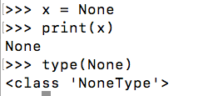
What is None?
Special dummy value
Null value or no value yet
Can set a variable to None

Slide 25
What is pass?
A null statement
Nothing happens
Used to allow things to compile (stub)
Even if not complete
Conditional requires at least one statement after the if
If x:
pass

Slide 26
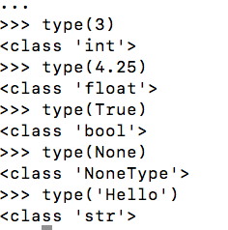
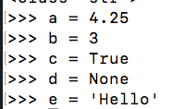
Types in Python
All variables have a type
Class name
Dynamically typed-language
Don't declare the type

Slide 27
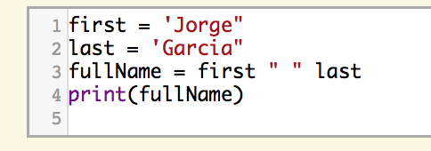
Strings in Python
Strings literals have pairs of
Single quotes: print('hello')
Double quotes: print("hello")
Triple quotes: print('''hello
there''')
You can append strings using +
It won’t add spaces for you
You can’t append a number to a string
Use str(number) to convert it
Or use commas to separate values
This code has errors. What are they?
Notes:
What is wrong with the example code on the right? - Both strings start with a single quote and end with a double quote. You must use the same starting and ending for strings. The third line is missing two + signs to concatenate the strings.

Slide 28
Strings are Objects
Strings are objects of the str class
Objects have state (data) and behavior (methods/functions)
String methods – use dot notation to execute
str.lower()
str.capitalize()
str.find(oStr) – returns the first index of oStr or -1 if not found
Access part of a string
str[start:end] returns a copy of the substring from start to end - 1
str[index] returns the character at the index
Length of a string
len(str)

Slide 29
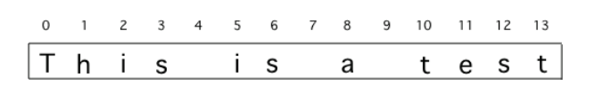
String indices start at 0
How would you get the "is" from the string?
STRING[5:7]
How would you get the "test" from the string?
See https://goo.gl/Wv8Kw3
Notes:
sentence = "This is a test“
w1 = sentence[:4]
print(w1)
w2 = sentence[5:7]
print(w2)
w3 = sentence[8:9]
print(w3)
w4 = sentence[len(sentence)-4:]
print(w4)

Slide 30
Peer Instruction Question #2
What is the value of y after this code executes?
s = "Cats"
y = s[-3:-1]
"at"
"ats"
"ts"
This code won't compile

Slide 31
String Slice - Create a copy of a substring
If you leave off the first index it defaults to 0
str[:3] is the same as str[0:3]
If you leave off the last index it defaults to the length of the string
str[2:] is the same as str[2:len(str)]
s[:] returns a copy of the whole string
You can use negative indices as well
-1 is the index of the last character in the string

Slide 32
Peer Instruction Question #3
What will the following print?
s = "Vampires"
print(s[3:-1])
res
ires
mpires
pires
pire
Notes:
See this execute at https://goo.gl/LC5dHD

Slide 33
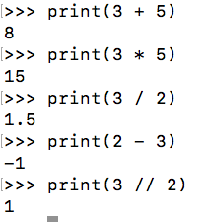
Math Operators
Name | Symbol | Example
addition | + | print(3 + 5)
multiplication | * | print(3 * 5)
division | / | print(3 / 2)
subtraction | - | print(2 – 3)
integer division | // | print(3 / 2)
Note that an integer divided by an integer returns a floating point
Use // for an integer result

Slide 34
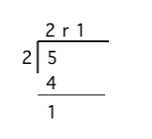
Modulo (Remainder)
% is the modulo or remainder operator
5 % 2 is 1
4 % 2 is 0
7 % 2 is 1
6 % 2 is 0
Notice a pattern?
What would 18 % 5 return?
Notes:
All odd numbers return a remainder of 1 when divided by 2. All even numbers return a remainder of 0 when divided by 2

Slide 35
Peer Instruction #4
What is returned from 3 % 4?
A) 0
B) 1
C) 2
D) 3
E) 4

Slide 36


Comments in Python
Use # to comment
Can start a line
Or can occur at the end of a line

Slide 37
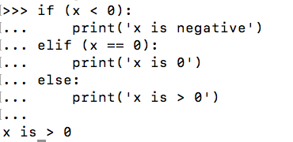

Conditionals in Python
Use if, elif (if needed), and else
Start each block with a ':'
Indent the statements in each block
Use 4 spaces
Use and, or, and not to create complex conditionals

Slide 38
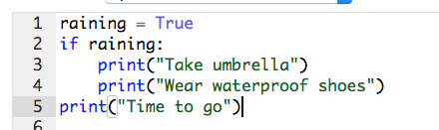
Indentation Matters!
Python uses indentation to indicate the statements in the body of a block of code
Which lines are in
the body of the
If conditional on line 2?
https://goo.gl/DkB6zD
Notes:
Go to https://goo.gl/DkB6zD

Slide 39


Functions
Many built-in functions in Python
print, range, max, len
Can also create your own functions
def name():
body statements
(optional return statement)

Slide 40
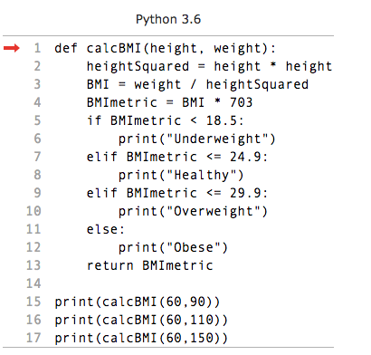
Example Function
BMI is Body Mass Index
height is in inches
weight is in pounds
Note that you define the function and call it. You can call it several times with different parameters (values).
Go to https://goo.gl/evp8HZ

Slide 41
Why Write Functions?
Name a group of statements
Makes the program easier to read and debug
Eliminate repetitive code
Makes code smaller and easier to change
Well designed and debugged functions can be reused

Slide 42
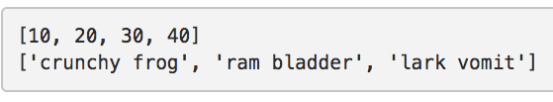

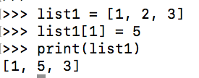
Lists
Lists hold items in order
Items can be of any type
They can even be different types
Lists can be modified

Slide 43
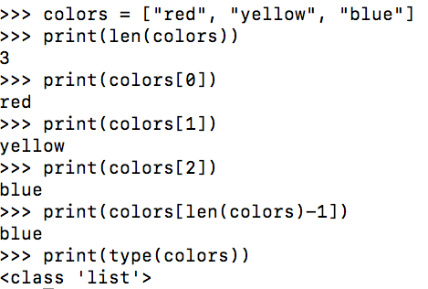
Accessing Items at an Index in a List
0
"red"
1
"yellow"
2
"blue"
The first item in a list is at index 0
The second item in a list is at index 1
Use len(list) to get the number of items in a list
The last item is at len(list) – 1
The type is class list

Slide 44

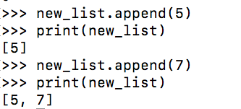
Create a List and Add to It
You can create an empty list
You can append items to the end of a list

Slide 45
Peer Instruction #5
While will the following code print?
list1 = [0, 1, 2]
list2 = ["a", "b", "c"]
list1.append(list2)
print(list1)
[0, 1, 2]
[0, 1, 2, "a", "b", "c"]
[0, 1, 2 ["a", "b", "c"]]
The code won't compile

Slide 46
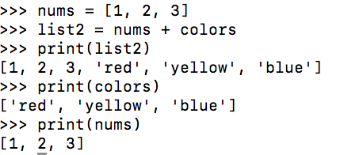
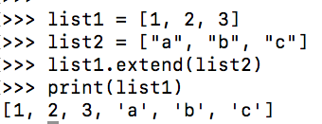
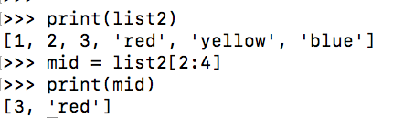
List Functions (Similar to String)
You can add lists together using "+" or extend
You can get a slice from a list
[start: end]

Slide 47
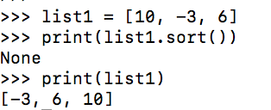
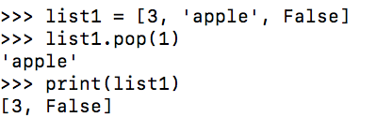
List Functions (use dot notation)
sort (modify the list from low to high) – doesn’t return anything
pop(index) – remove the item at the index and return it

Slide 48
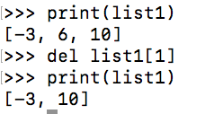
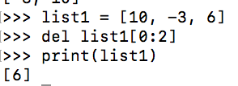
Another Way to Delete from a List
Can use del to delete an item from a list by index
Can even delete a section of a list

Slide 49
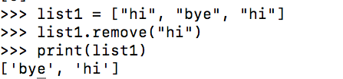
Yet Another Way to Delete from a List
Some_list.remove("hi")
Removes the first value from the list that matches

Slide 50
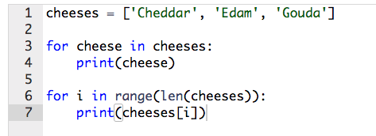
Looping Through Items in a List
You can easily loop through all the items in a list
Using a for-each loop
Using a for loop with indices

Slide 51
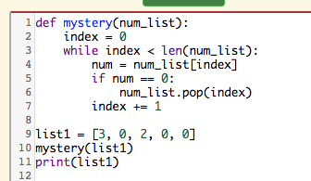
Peer Instruction #6
What will the following code print?
A) [3, 0, 2, 0, 0]
B) [3, 0, 2]
C) [3, 2]
D) [3, 2, 0]

Slide 52


Range Function
Returns an iterator
Object that has a next() method to get the next value in a sequence
Notice that it only prints to 9 but loops 10 times (from 0 to 9)

Slide 53
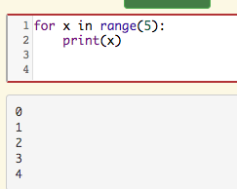
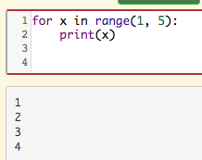
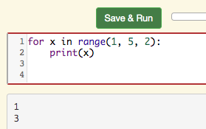
Three Ways to Use Range
range(end) – 0 to (end – 1) by 1 – Loops end times
range(start, end) – start to (end – 1) by 1
Range(start, end, step) – start to (end – 1) by step

Slide 54
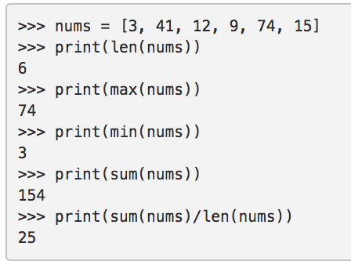
Functions that take Lists

Slide 55
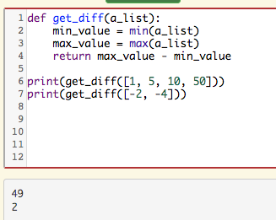
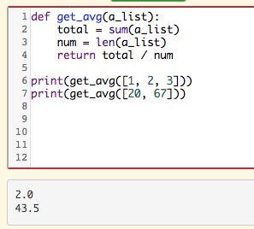
Example Functions

Slide 56
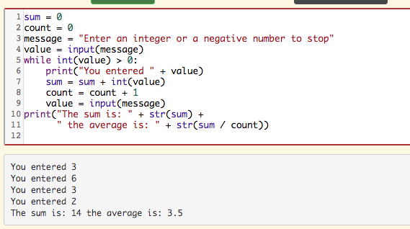
While Loops
Use a while loop when you don't know how many times to repeat

Slide 57
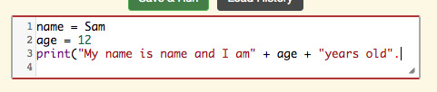

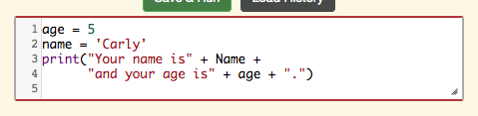
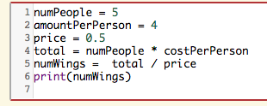
Common Syntax Errors
Missing one of a pair
()
[]
Single or double quote
Wrong case
Name versus name
Wrong name
amount vs cost

Slide 58

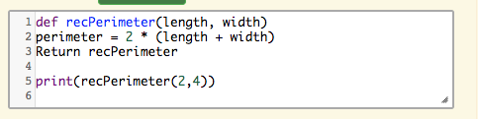

Common Syntax Errors
Using = instead of == for equality testing
Forgetting the : at the start of a block
Forgetting the + between strings

Slide 59




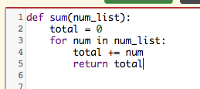
Other Common Errors
Divide by zero
Off by one
Early exit of a loop
Incorrect indentation

Slide 60



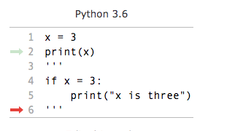
Debugging Strategies
Use the complier to tell you where to start
Look at the line number or above
Limit what is executed
Comment out things
Triple quote can be used for this
Track what is happening
Use print statements
Use a stepper like Python Tutor
Use the Codelens
Use a debugger

Slide 61
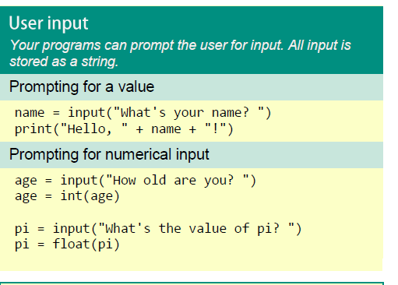
User Inputs
The next part of the lesson will be: https://tinyurl.com/y6egzg64
You can also run locally with the .py or .pynb files in the module
Notes:
Nothing too tricky here, but worth pointing out a few things:
input() takes one argument, which is the prompt that is displayed to the user. This can be a blank string if you don’t want to display a prompt.
When input() is called it displays the prompt and then waits. It will wait forever, until the user types something (or not) and then hits return (this is really what it’s waiting for).
Whatever the user typed (including, potentially, the blank string) will be returned from input(). This return value can be assigned to a variable (such as response) in our example. Your program can then do whatever it wants with the return value. You’ll do some simple problems using this concept and the others we’ve done before in lab this week.

Slide 62
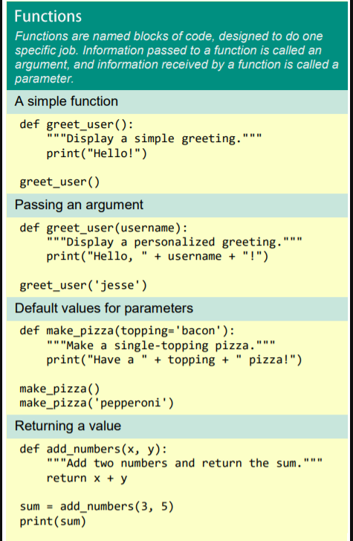
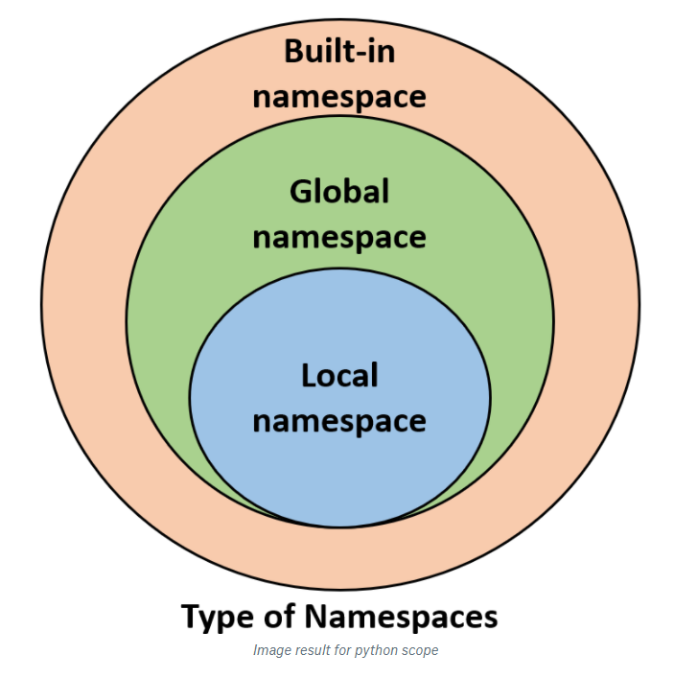
Functions Basics
The next part of the lesson will be: https://tinyurl.com/y6mblg8s
You can also run locally with the .py or .pynb files in the module
Notes:
Nothing too tricky here, but worth pointing out a few things:
input() takes one argument, which is the prompt that is displayed to the user. This can be a blank string if you don’t want to display a prompt.
When input() is called it displays the prompt and then waits. It will wait forever, until the user types something (or not) and then hits return (this is really what it’s waiting for).
Whatever the user typed (including, potentially, the blank string) will be returned from input(). This return value can be assigned to a variable (such as response) in our example. Your program can then do whatever it wants with the return value. You’ll do some simple problems using this concept and the others we’ve done before in lab this week.

Slide 63
Functions Wrap-up

Slide 64
Norms & Practices of Functions
Best Practices for Functions
use descriptive names (long and clear is better than short and cryptic)
Single Responsibility Rule
Keep functions short (<50 lines is a good guideline)
Avoid side effects
don't pass parameters you don't need
don't reference global variables
keep functions 'pure' by returning copies (this is controversial)
document your functions

Slide 65
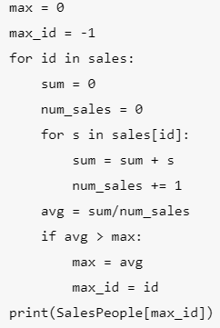

Descriptive Names
Functions simplify code – but only if the names are human interpretable
Original
interpretable
Useless

Slide 66
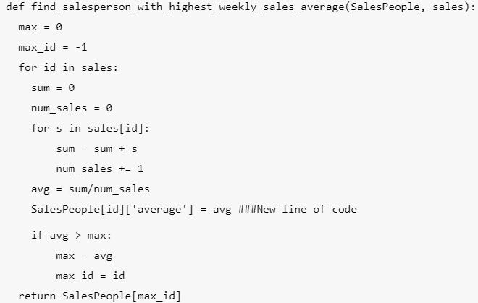
Single responsibility rule
Below we add 1 line to our first function from our last lesson
Seems useful but creates some downsides:
The function name is no longer descriptive
potentially duplicates effort
may create mis-matched formats
Single Responsibility Rule: Just write two different functions
See best practice on next slide

Slide 67
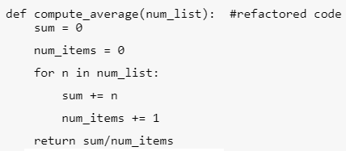

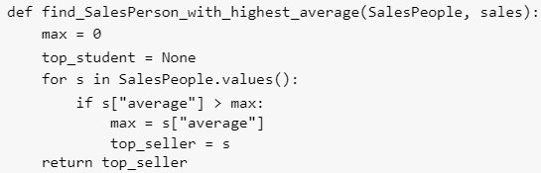
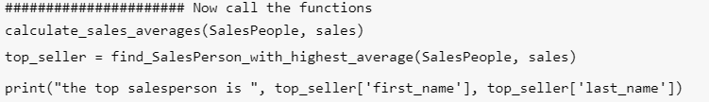
Best Practice

Slide 68
Keep Functions Short
50 lines or less

Slide 69
Avoid Side Effects
Let’s re-examine one of our earlier codes
This is actualy not great.
The parameter SalesPeople is modified - and it doesn't return anything.
The caller (person who calls the function) doesn't know if it ran or not.
This is tough to fix. Suggestion:
return something: return the SalesPerson dictionary to hint that it was changed
but notice that the parameter entered is the same as the object returned...
Therefore
Is the same as

Slide 70
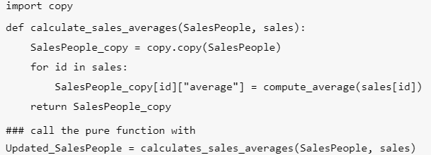
Keep functions pure?
Pure means:
No side effects
Don’t affect anything other than what is returned
Don’t access global variables other than parameter
Accomplish this by using copy
Here is a pure version of the calculate_sales_averages() function
Now the object that is returned from calculate_sales_averages() is actually different than the object SalesPeople that was passed into it
Are there downsides?

Slide 71


Downsides of Pure programming
This approach has downsides too:
Large objects are expensive
Complex Objects don't copy well
particularly true for objects with a lot of references to other objects.
Truly pure programming is overkill. but one good lesson is NEVER modify a global variable if you can avoid it. And if you can't use the local reference.
So
Is preferable to

Slide 72


Docstrings! Documentation is critical
The Numpy Standard https://queirozf.com/entries/python-docstrings-reference-examples#numpy-style

Slide 73
PEP8
https://pep8.org/
https://pypi.org/project/pep8/

